Slide 1






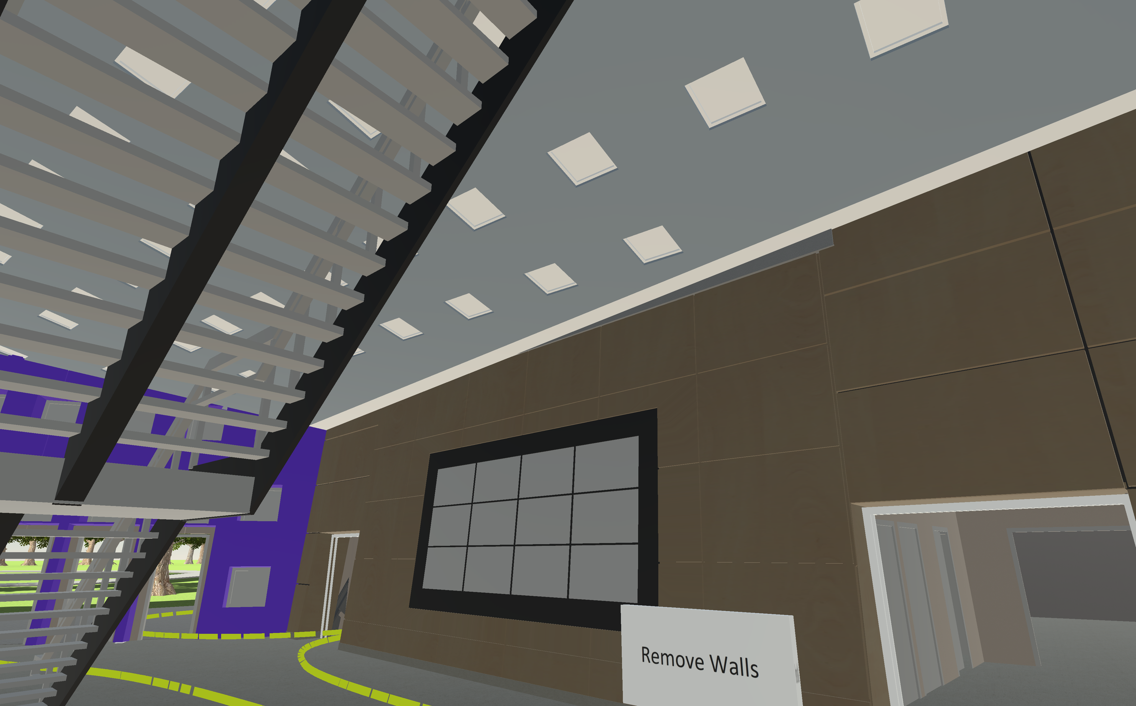
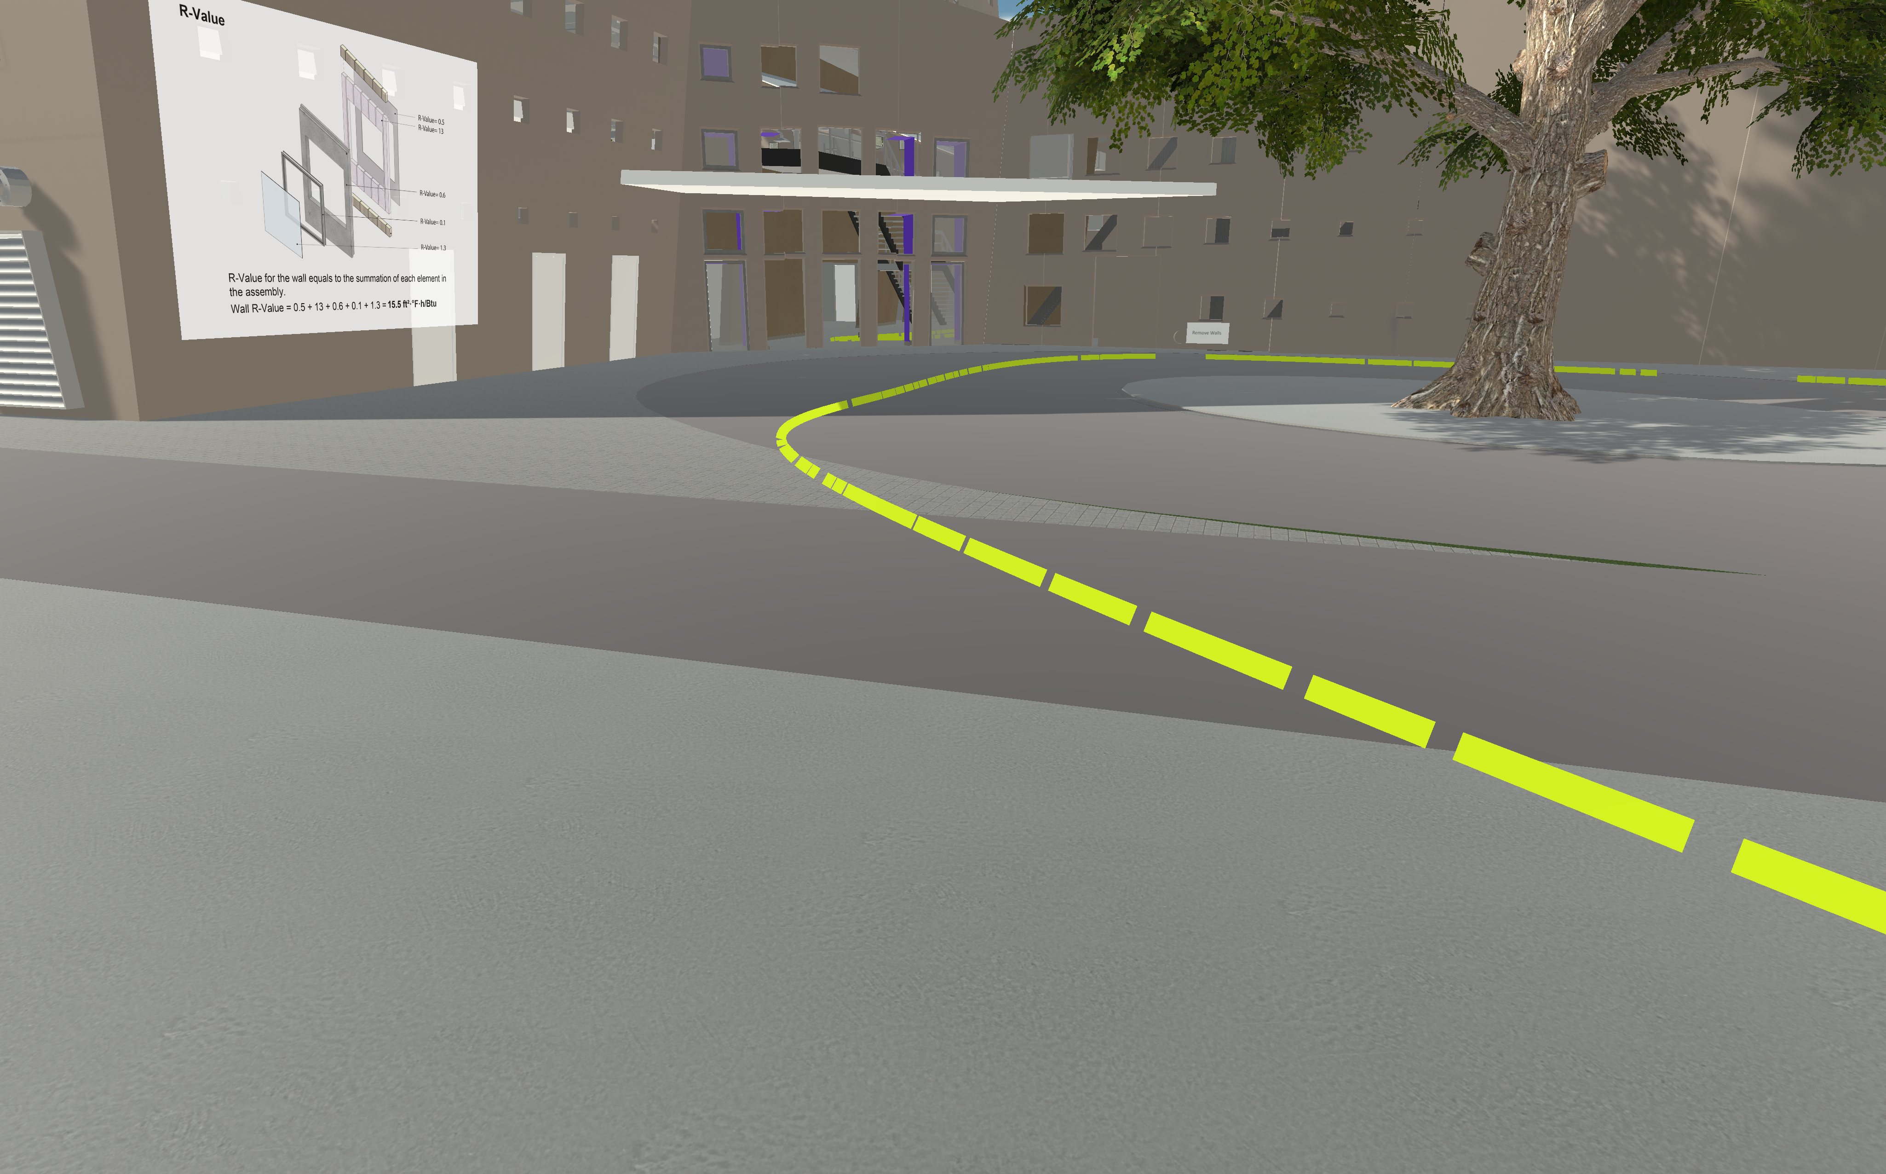
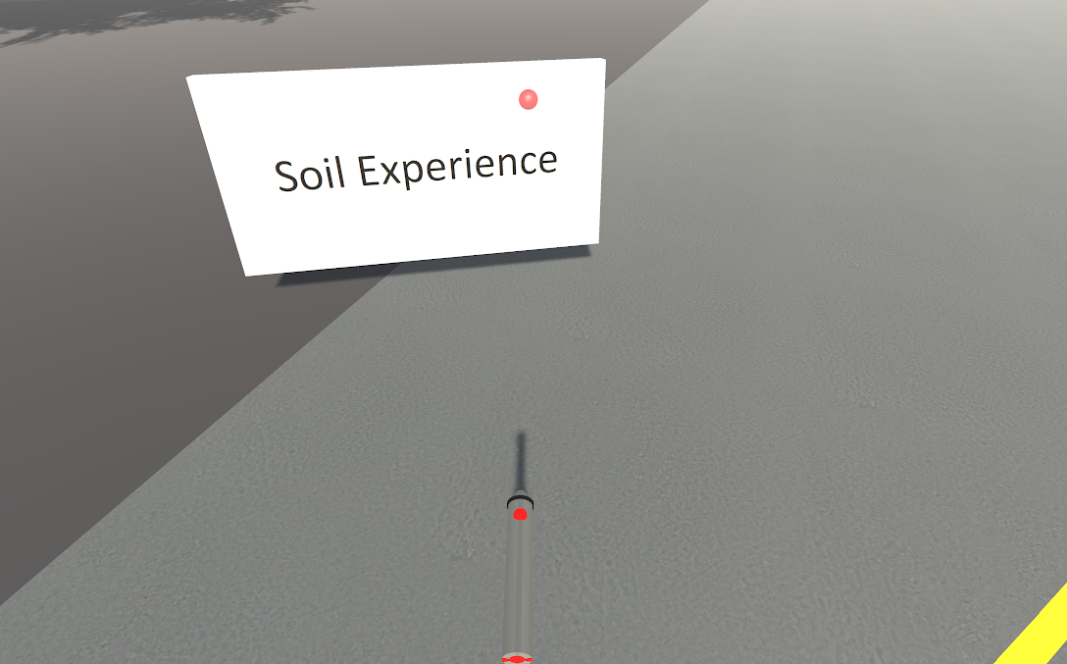
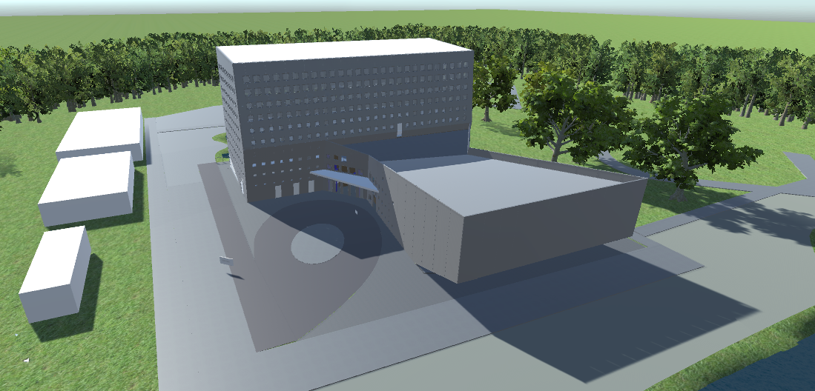
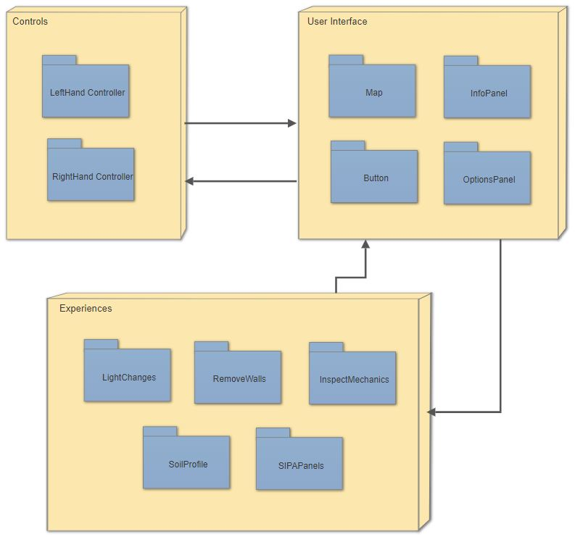
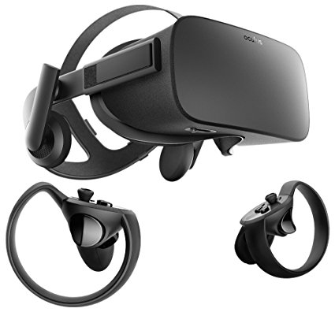



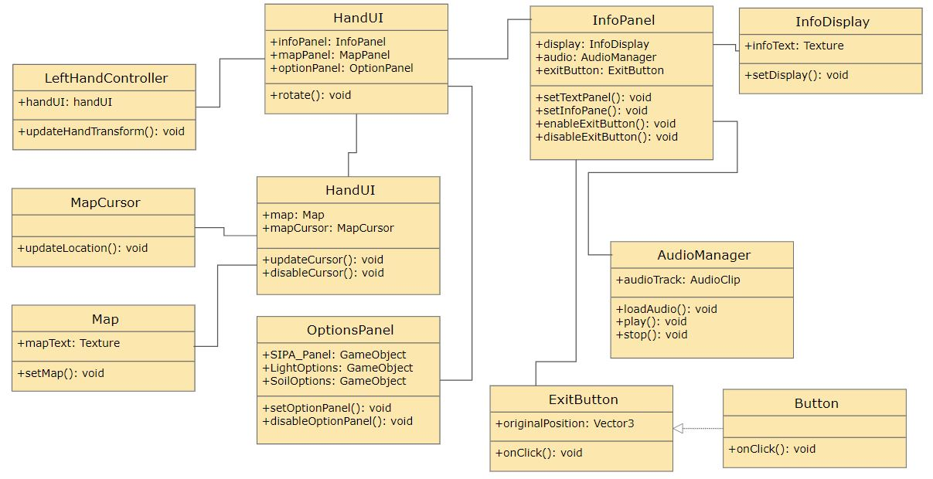
School of Computing & Information Sciences
Senior Project, 2018, Spring
Learning with Virtual Reality 5.0
Student: Roger Boza, Florida International University
Mentor: Shahin Vassigh, Florida International University
Professor: Masoud Sadjadi, Florida International University
Problem
Lighting inside of SIPA model is too dark (low visibility).
Model edges are jagged, sharp and rough.
User center pivot for rotation is eccentric.
Walkthrough particle guidance texture is missing.
Solution
Reposition the sun accordingly to illuminate the interior of the SIPA model.
Add anti-aliasing attributes to smooth edges.
Locate and change center pivot of user to center of body.
Create walkthrough particle texture.
Current System
Sun transitions across the sky illuminating the SIPA model.
Optimized full scale model of SIPA building.
Motion sickness alleviated with smoother transitions.
Visible walkthrough with intuitive guidelines.
Screenshots
Requirements
Accurate and comfortable user movement around the virtual world.
Intuitive pointer to select and point at objects.
Ability to play videos and show graphical assets.
Proper walkthrough and guidance system for user to follow.
Correctly display the soil animations in the model.
Align camera to the correct wall for the interactive wall experience.
System Design
Implementation
The system was implemented using Unity 3D for the environment model and the Oculus Rift for interactions in the Virtual Reality.
Verification
Object Design
Summary
Multiple experiences for the user to interact with.
Easy to follow walkthrough particle guidance system.
Accurate lighting and ambient illumination.
Smooth model transitions.
Optimized SIPA model for faster rendering.
Intuitive object pointer.
Test Case ID: Learning_vr_5.0_330 | (Sunny Day)
Purpose | To test the movement functionality of the new intuitive pointer model.
Preconditions | The user should be inside the virtual reality world. The user should have the left and right control on their hand.
Input | User moves the control.
Expected Output | Camera rotates to where the pointer is aiming. Visual guide shows path of pointer.
Acknowledgement
The material presented in this poster is based upon the work supported by Shahin Vassigh. I am thankful to the help that I received from my group members, Jerry Pujals.
Notes:
1

